Slide 1

Signals on GitHub

Slide 2


Overview
Signals on GitHUb
Background
Research Questions
Research Methods

Slide 3
Background
Information Asymmetry in Open Source Software development on GitHub under Pull-request model
How much efforts developers put on their work is private knowledge.
Quality of their code is private knowledge, and hard to assess.
Cherry-picking depends on many factors
Many technical and social factors, see Tsay et al. (2014).
Signals play some role in similar scenarios (Marlow & Dabbish, 2013).
Signals vs. Cherry-picking is not clear.
Typical Signals (From a user’s profile: stars, pinned project, activity heatmap, etc.)
Adding an extra signal?
Signals and True Quality

Slide 4
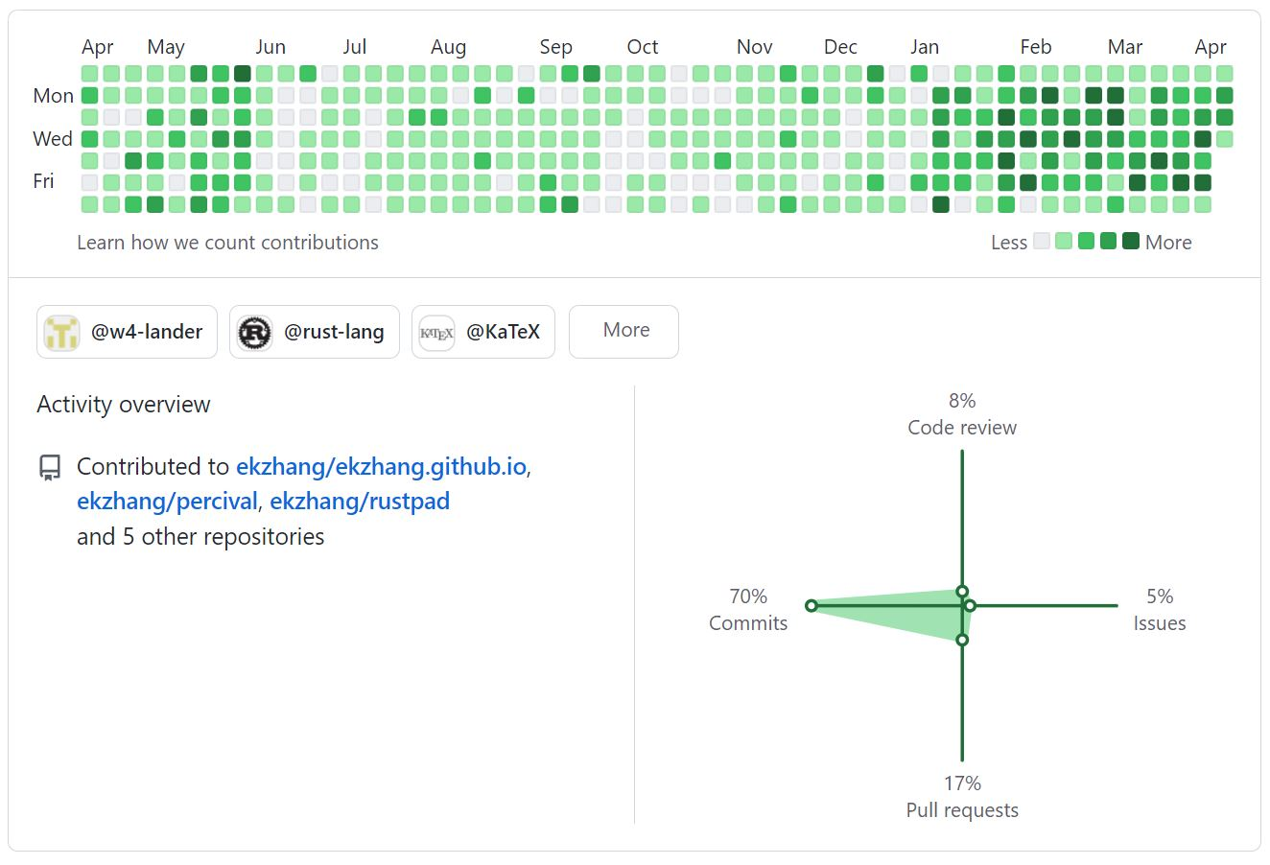
Yet another Signal
Everyone has this heatmap
But not everyone has activity overview
Activity overview itself is a composite signal

Slide 5
Some Research Questions
Activity overview is a new signal and has only been adopted by a small proportion of people, which offers a great opportunity to do a natural experiment.
That leads some interesting questions:
Who are likely to adopt this new signal?
Do their choices have any connections with their demographic information (tenure, project, gender, contributing frequency, activity profiles, etc.)?
Does using this signal pay back? E.g., higher pull-request acceptance rate？more privileges (becoming an elite developer)?

Slide 6
Research Methods
We may take an empirical approach to answer these questions, by studying a sample of developers.
Procedures:
1. selecting a sample of projects with diverse characteristics
2. identifying individual developers, building two sub-samples according to their adoptions
3. analyzing developers’ choices and various factors
4. building regressions to identifying adoption’s impact.

Slide 7

Thank you！

